Slide 1
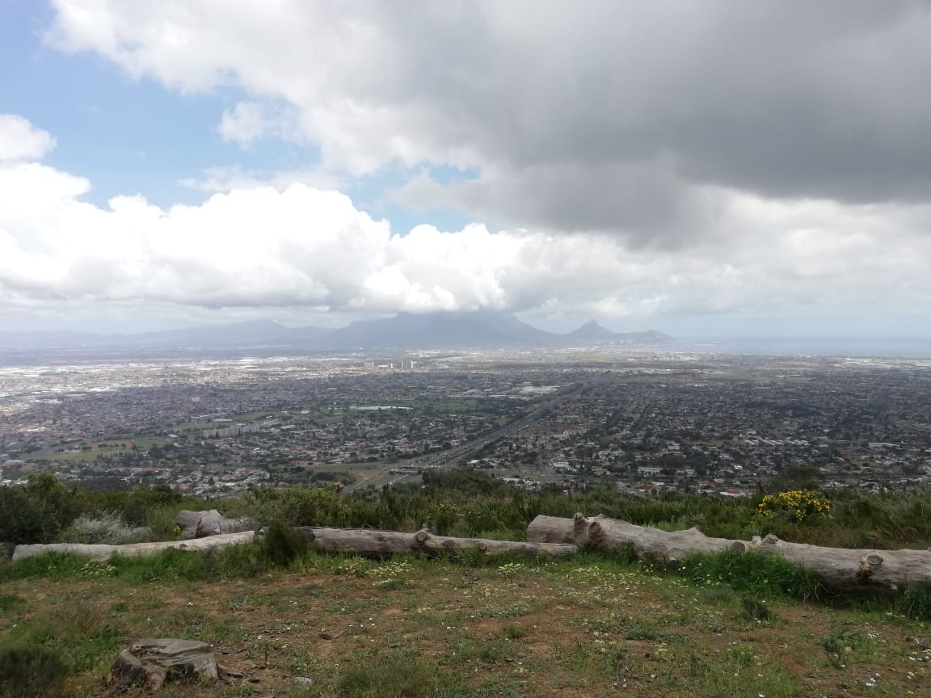
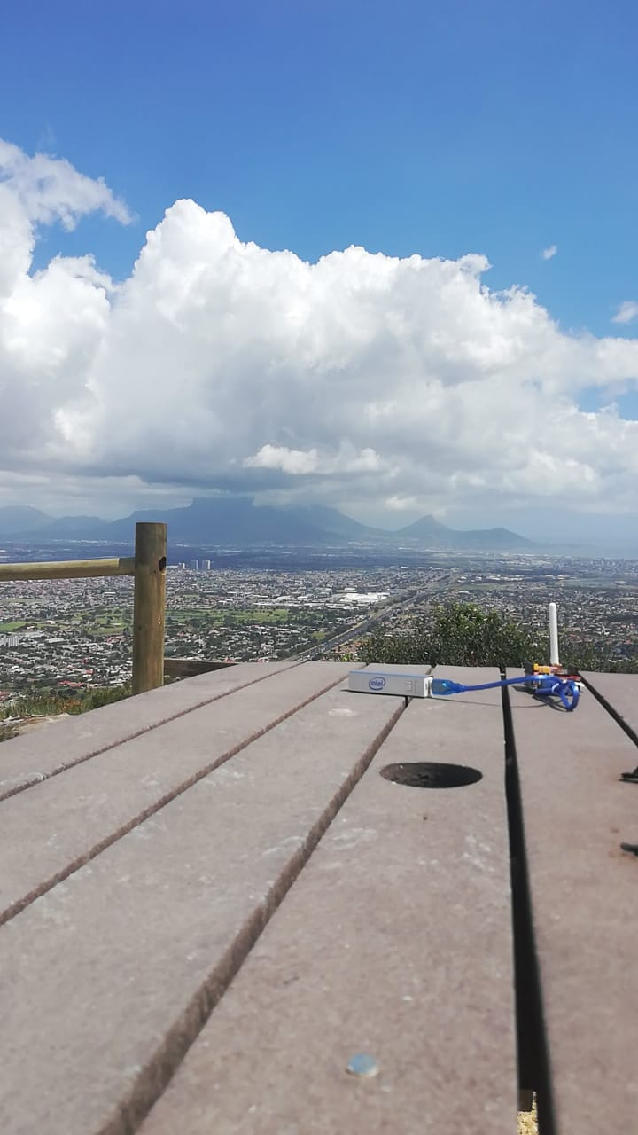
Sunny
Dark Rain
Clouds
Receiver Position
Rain
Transmitter Setup

